Slide 1
The Past as Prologue: The Drift, Drag and Drive of Our History […and Future?]
Closing Keynote
American Academy of Health Behavior
February 24, 2015
Lawrence W. Green
Department of Epidemiology & Biostatistics
School of Medicine
University of California at San Francisco
lwgreen@comcast.net
www.lgreen.net
Notes:
The phrase in the conference theme: “Using the Past to Propel the Future…” implies that we’ve been on the right track to affect a better future. I prefer “prologue” to “propel” because it implies an introduction to the future rather than accelerating what we’ve done in the past as if we don’t have some sins to atone for. or at least to predict, anticipate, and know what to watch out for as the future unfolds before our eyes.
Green, L.W., Ottoson, J.M. From efficacy to effectiveness to community and back: Evidence-based practice vs practice-based evidence. In Hiss, R., Green, L, Glasgow R., et al. (Eds). From Clinical Trials to Community: The Science of Translating Diabetes and Obesity Research. Bethesda: National Institutes of Health, 2004, pp. 15-18.
and
Green LW, Ottoson JM, Garcia C, Hiatt R. Diffusion theory and knowledge dissemination, utilization and integration. Annual Review of Public Health. Vol. 30 151-174 (Volume publication date April 2009) (doi:10.1146/annurev.publhealth.031308.100049). 2009. Full text in HTML or Print PDF: http://arjournals.annualreviews.org/doi/pdf/10.1146/annurev.publhealth.031308.100049.
…and several papers on the issues of practice-based evidence and external validity.
I’m concerned with Santayana's admonition that we are doomed to repeat the historical errors of the past if we don't study them, and perhaps even more, I'm concerned that we don't miss the boat altogether if we’re as oblivious to its schedule as previous species were.

Slide 2
The Challenges & Opportunities
The “drift and drag” of our two biggest challenges:
To close the gap between the evidence for implementation that policy makers, program planners, practitioners and communities need & what they are getting from our research and systematic reviews
Reform some of our peer review & editorial tendencies
The “drive” of our two biggest opportunities
Extend participatory research principles to work with policy makers, program planners & practitioners in use of natural experiments—e.g., evaluation and continuous quality improvement methods
Combine PR with multi-site RCT methods that expand the external validity of the results
Notes:
The “drive” opportunities I’ll illustrate later. Let’s focus first on the “drift and drag” of our major challenges. The first is the need need to bridge the gap between what has become, academic research products that feed publications, impact factor scores, promotion and tenure, but do little for real-world decisions in practice and policy….How do we get out of the echo chamber in which we talk to ourselves and our kind within a relatively closed system that rewards us mainly for our success in communicating with other academics…how do we avoid having the some aspects of our past propel the future?
Katz DL, Murimi M, Gonzalez A, Nijike V, Green LW. From Controlled Trial to Community Adoption: The Multisite Translational Community Trial. Am J. Public Health. Aug. 2011; 101(8): e17-e27 [Abstract]. See letter to editor - Katz DL, Green LW, Murimi M, Gonzalez A, Njike V (2012). The Multisite Translational Community Trial and Community-Based Participatory Research: A Failure to Communicate? Am J. Public Health. April 2012: 102(4): 581-582. [Link to obtain full text of article]; author reply 582-583.
Yano EM, Green LW, Glanz K, Ayanian JZ, Mittman BS, Chollette V, Rubenstein LV. Implementation and spread of interventions into the multilevel context of routine practice and policy: implications for the cancer care continuum. Journal of the National Cancer Institute Monograph 2012 (May); 44:86-99. [Abstract]
Green LW, Brancati FL, Albright A., & Primary Prevention of Diabetes Working Group. Primary prevention of type 2 diabetes: integrative public health and primary care opportunities, challenges and strategies. Family Practice. 2012 (Apr); 29 Suppl 1:i13-23. [Abstract] [Free Full Text]
Jagosh J, Macaulay AC, Pluye P, Salsberg J, Bush PL, Henderson J, Sirett E, Wong G, Cargo M, Herbert CP, Seifer SD, Green LW, and Greenhalgh T. Uncovering the Benefits of Participatory Research: Implications of a Realist Review for Health Research and Practice. Milbank Quar. Jun 2012; 90(2): 311-346. doi: 10.1111/j.1468-0009.2012.00665.x. PMID: 22709390. [Abstract]

Slide 3
The Causes of Rift, Drift & Drag
Misplaced precision
In testing and deconstructing theoretical models
In generalizing to diverse settings and populations*
In confusing statistical with practical significance
Misplaced faith in unnatural experiments
Misplaced belief in generalizable fixed effects
Misplaced pursuit of singular, mostly downstream causes and interventions
Misplaced dichotomies and categorical variables
Notes:
What are the causes of this rift, and the consequent drift and drag of our evidence not reaching, or reaching but not convincing practitioners and policy makers of their applicability to their situations. The rift is sometimes characterized as a “gap”…in one IOM (NAM) report, a “chasm” between research and practice, or between “evidence” and its implementation in practice or policy. The evidence we produce is received with skepticism by practitioners, because they doubt its applicability to their circumstances, their populations, and their first-hand knowledge and professional judgment of the individual or local variations among these circumstances and population segments.
I’ll come back to the issue of professional judgment for adaptation of evidence vs. “fidelity” in the implementation evidence-based practices.
1. Misplaced precision in testing theoretical models is my criticism of health behavior researchers in professional schools…who start with a theory and look for a problem on which to test it, rather than starting with a problem in medicine, nursing, or public health and using theory to help solve it. The generalization problem is our scientific duty to find generalizable principles, but we err when we underestimate or ignore the tremendous variability of diverse settings and populations. That leads, in turn, to confusing statistical significance with practical significance.
______
*In econometrics and statistics, a fixed effects model is a statistical model that represents the observed quantities in terms of explanatory variables that are treated as if the quantities were non-random. This is in contrast to random effects models and mixed models in which either all or some of the explanatory variables are treated as if they arise from random causes. Contrast this to the biostatistics definitions,^{[1][2][3][4]} as biostatisticians use "fixed" and "random" effects to respectively refer to the population-average and subject-specific effects (and where the latter are generally assumed to be unknown, latent variables).

Slide 4
The Drag
After innovating with quasi-expt’l and mixed-method designs as we tried to get at complexities of population-level, socially-conditioned behaviors, we had to retreat back to RCTs
More-rigorous-than-thou ethic in peer review
NIH budgets and peer review became stiffer, pay lines sank, and research retreated to safer designs and methods that would fit systematic reviews

Slide 5
The Causes of Renewed Drive
The ascendency of ecological models and systems thinking in challenging RCT limitations
The intensification of theory testing
The emergence of community-based & patient-centered participatory research
The influence of evidence-based practice criteria limiting funding of robust, innovative programs
Notes:
1. The series of IOM reports on the Future of Public Health and Schools of Public Health
2. The IOM reports on evaluation of CDC Prevention Research Centers

Slide 6
E.g., The Health Belief Model
The behavioral science group hired by Mayhew Derryberry for the USPHS Health Education Div.
Hochbaum’s study of why people did or did not avail themselves of mobile screening units
The belief in susceptibility to the problem was emblazoned as the first belief identified.
Second belief, “belief in severity”?
The subsequent history of the model…*
Meta-analyses…and fidelity vs. adaptation*
*Harrison J, Mullen PD, Green LW. (1992). A meta-analysis of studies of Health Belief Model with adults. Health Educ. Res. 7(1):107-116.
Notes:
Since this year’s AAHB conference celebrates the 60th anniversary of the Health Belief Model, let us consider how it has played out in the history of health behavior research. The second belief from the original research, contrary to common applications of the model, was “belief that one can have the problem without knowing it—the “asymptomatic belief”
Lessons from this history
1. In using theories, retrace the historical origins and reasons why the theory or model was changed.
2. If it was adapted, what were the circumstances and population characteristics that called for change…
3. Don’t wait for NIH to disseminate or implement your NIH-funded research…
Abstract of Harrison J, Mullen PD, Green LW. (1992). A meta-analysis of studies of Health Belief Model with adults. Health Educ. Res. 7(1):107-116. “The Health Belief Model (HBM) relates a socio-psychological theory of decision making to individual health-related behaviors. We conducted a meta-analysis of the relationships between four HBM dimensions (Susceptibility, Severity, Benefits and Costs) and health behavior on 16 studies that measured all four of the dimensions, measured a behavioral dependent variable and included some measures of reliability, minimal criteria for establishing the validity of the dimensions. Mean effect sizes were computed for all the studies, subgroupings representing studies of screening, risk reduction and adherence to medical regimen, and prospective and retrospective study designs. Of 24 mean effect sizes, 22 were found to be positive and statistically significant. The actual variance accounted for ranged from 0.001 to 0.09. Homogeneity was rejected for 15 of the 22, however, suggesting that the same underlying construct was not measured. Retrospective studies were found to have significantly large effect sizes for benefits and costs and smaller effect sizes for severity when compared to prospective studies. The weak effect sizes and lack of homogeneity indicate that it is premature to draw conclusions about the predictive validity of the HBM as operationalized in these studies. Our finding of only 16 studies meeting minimal criteria for valid representation of the HBM dimensions indicates that future studies should focus more on such issues.

Slide 7
A Brief History of Systematic Reviews Driving Medicine & Public Health
R.A. Fisher (1926) testing of hybrid seeds in agriculture
Archie Cochrane, & D. Bradford-Hill, UK, 1960s
David Sackett, McMaster Univ., Canada, 1970s
Brian Haynes, founding editor, J. Evid.-Based Med., 1970-80s
Haynes & Sackett, McMaster conf. Compliance in Health Care, 1979
Gord Guyat, GRADE criteria for systematic reviews
Canadian Task Force, USPSTF & Cochrane, 1980s-present
Community Preventive Services Task Force, 90s
Federal OMB of the Bush Administration, 2002
Agency directories of evidence-based practices
Funding of programs requiring EBPs 2002
USPSTF reviews set Medicare reimbursement
2004 CDC & CPSTF promote “practice-based evidence”
Notes:
A. L. Cochrane. Effectiveness and Efficiency: Random Reflections on Health Services. 3nd edition. London: The Royal Society of Medicine Press, 1999. Originally published by Nuffield Provincial Hospitals Trust, 1972, Reprinted with a new introduction, 1999.
David Sackett, et al. Evidence based medicine: what it is and what it isn’t. BMJ 312:71, 13 Jan., 1996.
Grahame-Smith D. Evidence based medicine: Socratic disent.BMJ1995;310:1126-7.
Evidence based medicine; in its place[editorial]. Lancet1995;346:785.
Correspondence. Evidence based medicine.Lancet1995;346:1171-2.
Weatherall DJ: The inhumanity of medicine. BMJ1994;309;1671-2.
House of Commons Health Committee. Priority setting in the NHS: purchasing. First report sesions
1994-95. London: HMSO, 1995. (HC 134-1.)
Davidoff F,, Haynes B, Sackett D, Smith R. Evidence based medicine: a new journal to help doctors
Identify the information they need. BMJ1995;310:1085-6.
Sackett DL. Surveys of self-reported reading times of consultants in Oxford, Birmingham, Milton-
Keynes, Bristol, Leicester, and Glasgow. In: Rosenberg WMC, Richardson WS, Haynes RB, Sackett DL. Evidence-based medicine. London:Churchill Livingstone (1999).
ElisJ, MulliganI,RoweJ,SackettDL. Inpatient general medicine is evidencebased.Lancet
1995;346:407-10.
Bennett RJ, Sackret DL, Haynes RB, Neufeld VR. A controlled trial of teaching critical appraisal
Of the clinical literature to medical students. JAMA1987;257:2451-4.
Green, L.W. Educational strategies to improve compliance with preventive and therapeutic regimens: The recent evidence. Chapter 10 in Haynes, R.B., Taylor, D.W., Sackett, D.M. (eds.), Compliance in Health Care. Baltimore: Johns Hopkins University Press, 1979, pp. 157-173.
https://upload.wikimedia.org/wikipedia/commons/4/46/R._A._Fischer.jpg

Slide 8
David Sacket, Brian Haynes, Gord Guyatt
Notes:
See previous slide for Sacket and Haynes references.
Guyatt G. 2011a. GRADE guidelines: 4. Rating the quality of evidence - study imitations (risk of bias)
Guyatt G. 2011b. Introduction - GRADE evidence profiles and summary of findings tables
Kumar A1, Miladinovic B2, Guyatt GH3, Schünemann HJ3, Djulbegovic B4. GRADE guidelines system is reproducible when instructions are clearly operationalized even among the guidelines panel members with limited experience with GRADE. J Clin Epidemiol. 2016 Feb 2. pii: S0895-4356(16)00089-5. doi: 10.1016/j.jclinepi.2015.11.020. [Epub ahead of print]

Slide 9
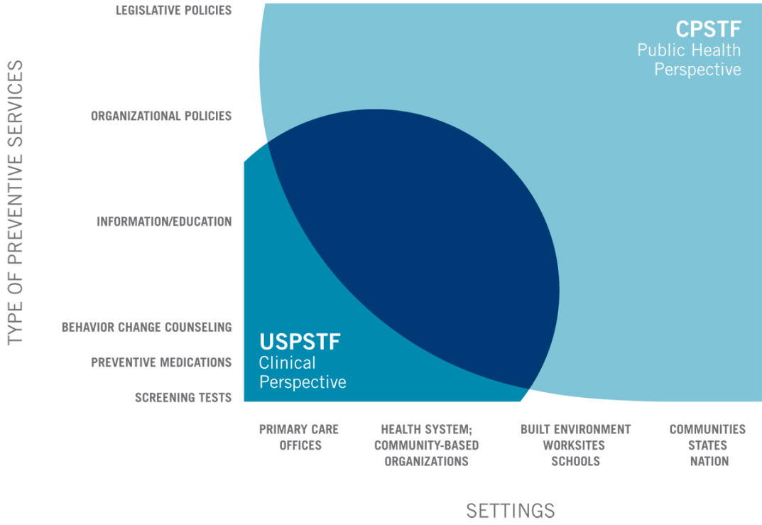
Multi-level Complementarity of USPSTF & CPSTF
Notes:
The Community Preventive Services Task Force (staffed by CDC) is complementary to the US Prev Services Task Force (staffed by AHRQ) in expanding the scope of interventions systematically reviewed and recommendations made on effectiveness of interventions. Chart from the 2015 Community Preventive Services Task Force Annual Report to Congress: and to Agencies Related to the Work of the Task Force. See www.thecommunityguide.org website maintained by CDC.

Slide 10
Where Have All the Data Gone? Longtime Passing...♬♪
17 yrs
“It takes 17 years to turn 14 per cent of original [applied] research
to the benefit of patient care” *
Original research
Submission
Unknown
0.5 year
0.6 year
0.3 year
6. 0 - 13.0 years
9.3 years
Kumar, 1992
Kumar, 1992
Poyer, 1982
Antman, 1992
Acceptance
Publication
Bibliographic databases
Reviews, guidelines, textbooks
Implementation
18%
Negative results
46%
35%
50%
Lack of numbers,
Design issues
Lack of numbers,
Design issues
*Balas, 1995
Inconsistent
indexing
Dickersin, 1987
Koren, 1989
Poynard, 1985
Notes:
10
*Article by Andrew Balas (Balas EA, Boren SA. Managing Clinical Knowledge for Health Care Improvement. Yearbook of Medical Informatics 2000: Patient-centered Systems. Stuttgart, Germany: Schattauer, 2000:65–70) set in motion a movement for consumers as co-producers of health care quality through consumer informatics.

Slide 11
R
The Pipeline Fallacy of Producing & Vetting Research to Get Evidence-Based Practice*
Basic
Research
The 17-year odyssey
Practice
Guidelines for
Evidence-Based
Practice
Funding/ client or
Population needs,
demands; local
practice or policy
circumstances;
professional
discretion;
credibility & fit of
evidence
the evidence. patient
Research
Synthesis
Publication
Priorities &
Peer Review
Peer Review
Of Grants
Priorities for
Research Funding
Evidence-based
Medicine
movement
Academic appointments,
promotion, & tenure
criteria
Impact Factor
Scoring**
Blame the practitioner or
blame dissemination
*Green LW (2008). If it’s an evidence-based practice, where’s the practice-based evidence? J Family Med 25 (suppl_1): 20-24; **J Partic Med 2009;1(1).http://jopm.org/index.php/jpm/article/view/16/31.
Notes:
Starting with the setting of priorities on what gets solicited in federal RFAs, RFPs and other solicitations for research, and in foundation announcements of research grant programs… So it is truly a systemic problem that limits what gets researched, what gets published, what gets included in the systematic reviews that lead to guidelines, how much the guidelines miss the mark of what practitioners, planners and policymakers need, and therefore what they use and implement of the research that has been disseminated to them. Appreciate the discussion Monday morning on how to quantify “impact” on on practice & policy.

Slide 12
Glaziou P. The role of open access to reducing waste in medical research. Plos Med.
2014;11(5):e100f651. Also in Chambers I. & Fox DM. Increasing the incidence and
influence of systematic reviews on health policy and practice. AJPH 2016;106(1):11-13.
Notes:
This representation of the pipeline gives more detail to the dissemination and implementation end, but it perpetuates the linearity, one-way flow fallacy of thinking about and acting upon the engagement perspective. Here is another way in which our early history in behavioral research

Slide 13
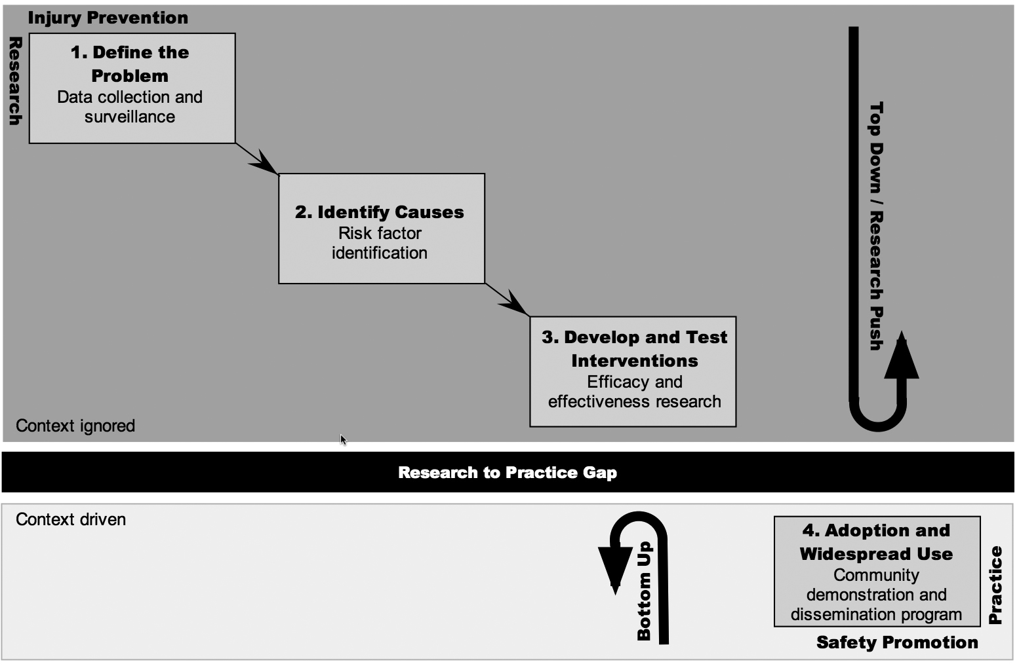
Meeting the Top-Down Evidence Push with Bottom-Up Practice-Based Evidence*
*CDC, National Center for Injury Prevention & Control, as adapted by Hanson DW, Finch CF, Allegrante JP, Sleet DA. Closing the gap between injury prevention research & community safety promotion practice: Revising the public health model. Public Health Reports 2012;127(2), p. 147.
*CDC, USDHHS, adapted by Hanson DW, Finch CF, Allegrante JP, Sleet DA. Closing the gap between injury prevention research and community safety promotion practice: Revisiting the public health model. Public Health Reports, 2012;127(2), p 147
Notes:
*CDC, USDHHS, adapted by Hanson DW, Finch CF, Allegrante JP, Sleet DA. Closing the gap between injury prevention research and community safety promotion practice: Revisiting the public health model. Public Health Reports, 2012;127(2), p 147

Slide 14
The Drag of Prevailing Standards of Evidence Limited to the Randomized Controlled Trials
Change in outcome variable(s) measured & compared between experimental & control groups
Mediating (and moderating) variables expected to change, based on previous evidence and theory
Intervention
tested by comparison with a control condition
Context
Context
--Comparison based on average
change for each group
--Subgroup analysis discouraged
--Dropouts discounted, ignored
--Cut-off date for outcomes often
too soon for change to occur
--Interventions highly standardized.
--Interventions reduced to simplistic form
--Everything else held constant.
--Clients randomized, no choice.
--Interventionists have no discretion.
Notes:
Limitations of the RCT

Slide 15
What’s Good for Scientists Not Necessarily Good for Science*
Leveraging chance by running many low-powered studies, rather than a few high-powered ones (Ioannidis, 2005);
Uncritically dismissing “failed” studies as pilot tests or because of methodological flaws but uncritically accepting “successful” studies as methodologically sound (Bastardi et al., 2011; Lord et al., 1979);
*Nosek et al., Scientific utopia: Restructuring incentives and practices to promote truth
over publishability. Perspectives on Psychological Science. 2012;7:615.

Slide 16
Scientists vs Science (cont’d)
Selectively reporting studies with positive results and not studies with negative results (Greenwald, 1975; John et al., 2012; Rosenthal, 1979) or selectively reporting “clean” results (Begley & Ellis, 2012; Giner-Sorolla, 2012)
Stopping data collection as soon as intended effect is obtained (John et al., 2012; Simmons et al., 2011; Green et al., 2010)
Notes:
Begley, C. G., & Ellis, L. M. (2012). Raise standards for preclinical cancer research. Nature, 483, 531–533.
Giner-Sorolla, R. (2012). Science or art? How esthetic standards grease the way through the publication bottleneck but undermine
science. Unpublished manuscript.
Green LW, Travis JW, McAllister RG, Peterson KW, Vardanyan AN, Craig A. Male circumcision and HIV prevention: Insufficient evidence and neglected external validity. Am J Prev Med. Nov 2010;39(5):479-82. Full text online.
Greenwald, A. G. (1975). Consequences of prejudice against the null hypothesis. Psychological Bulletin, 82, 1–20.
John, L., Loewenstein, G., & Prelec, D. (2012). Measuring the prevalence of questionable research practices with incentives
for truth-telling. Psychological Science, 23, 524–532. doi:10.1177/0956797611430953
Simmons, J. P., Nelson, L. D., & Simonsohn, U. (2011). False-positive psychology: Undisclosed flexibility in data collection
and analysis allows presenting anything as significant. Psychological Science, 22, 1359–1366.

Slide 17
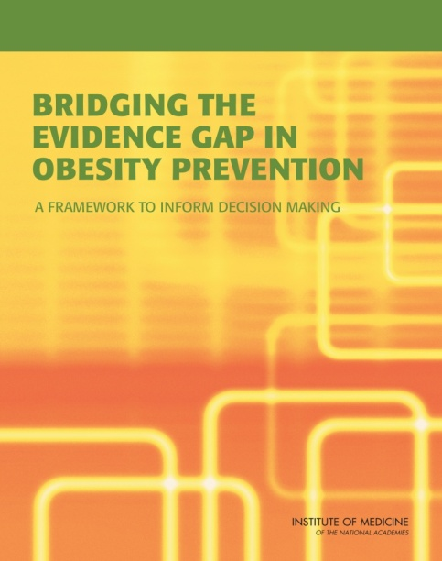
Problems Identified by IOM Report*
Narrow focus: Lack of attention to larger systems context
Lacking details of implementation process
Lack of relevance to real world
Many studies focus on one intervention, but obesity may require a combination of interventions; in fact, some things appear not to work when tested alone, but are essential ingredients in a more comprehensive program (www.nap.edu)
*Institute of Medicine. Bridging the Evidence Gap in Obesity Prevention: A Framework to Inform Decision Making. Washington, DC: The National Academies Press, 2010.
Notes:
Let’s see how some of the concerns I’ve mentioned have played out in recent IOM (now National Academy of Medicine) reports.
* Website for full text to read online, or to download an electronic copy, or to order a print copy: www.nap.edu.

Slide 18
IOM Conclusions about Status of Evidence
The current evidence lacks the power to set a clear direction for obesity prevention across a range of target populations
This lack of evidence for effectiveness seen as a lack of effectiveness
It is difficult to fund, conduct & publish research on community, environmental, and policy-based obesity prevention initiatives
Assessing or reporting on generalizability of research results to other populations or settings has not been given priority

Slide 19
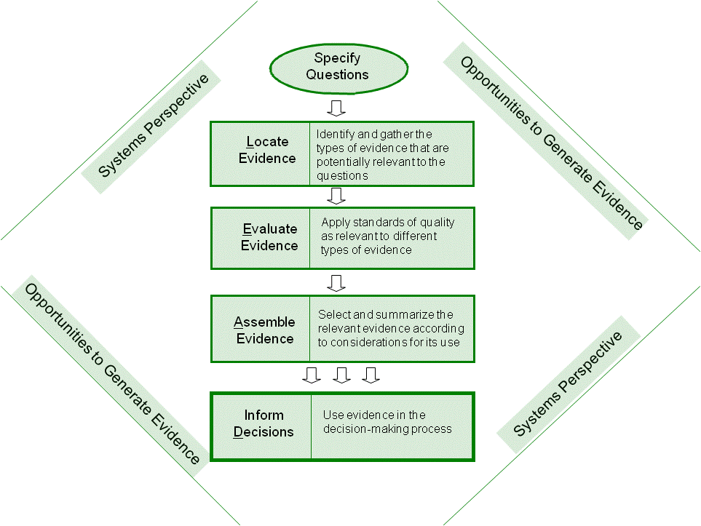
The L.E.A.D. Framework
Institute of Medicine. Bridging the Evidence Gap in Obesity Prevention.
Washington, DC: The National Academies Press, 2010. (www.nap.edu)
Notes:
With these questions and caveats in mind, the committee developed the L.E.A.D. framework, short for Locate evidence, Evaluate it, Assemble it, and Inform Decisions. This framework is designed to provide decision makers and researchers with a process for using evidence to inform decision making and for generating additional useful evidence.

Slide 20
Types of Community-Engaged Evidence for Health Research
Participatory research evidence
Community-Based Participatory Research (CBPR)
Practice-based or action research
Surveillance evidence
Population diagnostic evidence
Program evaluation evidence
Multi-component; Continuous Quality Improvement
How context effects (moderates) outcomes
Notes:
There is nothing truly new about these, but they are neglected in comparison with the emphasis on publishing and using as guidance for policy and practice the types of evidence drawn from randomized controlled trials.

Slide 21
Pause for Deliberation
AAHB proposal for a new journal
Online, open-access
Cost for publication
Limit to theory-testing
Alternatives?

Slide 22
The Spheres of Practice-Based, Community-Based, Academic & Participatory Research
Participatory
Research
Practice- Based Research
Highly Controlled Academic Research
Community-
Based
Research
CBPR
Notes:
Practice-based research, either “action research” or “participatory”

Slide 23
Three Paradoxes
The internal validity–external validity paradox
The more rigorously controlled a study testing the efficacy of an intervention, or the validity of a theory, the less reality-based it becomes, so it cannot be taken to scale or generalized
The specificity – generalizability paradox
The more relevant and particular to the local context, the less generalizable to other contexts
The homophily–social distancing paradox
Notes:
The first is the one that most justifies the investment in CBPR approaches. The second presents its limitation or trade-off. The third paradox presents the homophily-heterophily dilemma in trying to integrate the project into the community, the community into the project, and the community health worker caught in the middle…

Slide 24
Number of Publications on CBPR Based on Scopus Search*
*Based on unpublished Scopus review by Doug Brugge, Tufts U., 2011.

Slide 25
Top 9 journals publishing CBPR papers
Progress in Community Health Partnerships: Research, Education & Action (87)
American Journal of Public Health (49)
Journal of Health Care for the Poor and Underserved (33)
Health Promotion Practice (30)
Environmental Health Perspectives (29)
Ethnicity and Disease (26)
Health Education and Behavior (25)
American Journal of Preventive Medicine (21)
Journal of Urban Health (21)
*Based on unpublished Scopus review by Doug Brugge, 2011

Slide 26
Second Tier of CBPR Journals*
Social Science and Medicine (16)
Journal of Empirical Research on Human Research Ethics (14)
AIDS Education and Prevention (14)
Family and Community Health (14)
American Journal of Community Psychology (13)
American Journal of Bioethics (13)
Cancer (13)

Slide 27
Subject Areas with Most CBPR Pubs*
Medicine & Public Health (1,056)
Social Sciences (407)
Nursing (187)
Environ Science (141)
Psychology (118)
Agricultural & Biological Science (54)
Health Professions (53)
Biochemistry, Genetics and Molecular Biology (49)
Business, Management and Accounting (33)
Economics, Econometrics and Finance (22)
Engineering (19)*
*Scopus
Notes:
*Livingood W, Allegrante J, Airhihenbuwa C, et al. 2012, Applied social and behavioral science to address complex health problems. Amer J Prev Med. 2011;41(5):525-31. [Abstract] [Free Full Text]

Slide 28
The Lenses of Scientists, Health Professionals and Lay People*
Subjective
Indicators
of Health
Professional,
Scientific
Layperson
Objective
Indicators
of Health
*Green & Kreuter, Health Program
Planning. McGraw-Hill, 2005.
Notes:
We come then to the recognition that to be more patient-centered or community-based…we need to see health through the eyes of the patient or community, and that brings us to the methodological lenses through which we view and measure health. And the first among those is what we are measuring as outcomes, what we take as important end-points. Our professional lens tends to give us sharp acuity on what we call objective indicators of health.

Slide 29
Closing the Gaps Between Population & Scientists’ or Practitioners’ Perception of Needs, and Policy/Funders’ Assessments*
The public
sphere
People’s
perceived needs,
priorities
“Actual
needs”
The research
sphere
A
A
Resources,
feasibilities,
policy
The policy &
practice sphere
*Green & Kreuter, Health Program Planning, 4th ed., NY: McGraw-Hill, 2005, p. 40.
Notes:
If community-based approaches are to address what people consider important among their priorities, and are to mobilize indigenous resources to provide for home-grown solutions and for sustainability of programs, then we have to consider three world views bearing on the setting of priorities and getting agreement on the sphere of action. We tried to do this with the Precede-Proceed Model with sequential planning phases. This model taps public perceptions or social diagnosis through…using focus groups, nominal group process, questionnaires...

Slide 30
Reconciling Perceived Needs, “Actual Needs,” & Resources*
People’s
perceived needs,
priorities
“Actual
needs”
Health education
Participatory research
Action
Policy
Research &
Surveillance
Advocacy for policy,
regulation &
organizational
development
Resources,
feasibilities,
policy
*Source: Green LW & Kreuter MW. Health Program Planning, 4th edition, 2005. p.41.

Slide 31
New (neglected) Evidence Forms
Participatory research evidence
Community-Based Participatory Research
Practice-based or action research
Surveillance evidence
Population diagnostic evidence
Program evaluation evidence
Multi-component evaluations
Continuous quality improvement
How context effects (moderates) outcomes
Notes:
The last with mixed methods.

Slide 32
Uses of Evidence & Theory in Population-Based, Diagnostic, Planning & Evaluation Models*
Evidence
from community
or population
1. Assess Needs & Capacities
of Population
Evidence from
Etiologic Research
Reconsider X
2. Assess Causes (X) & Resources
4. Evaluate Program
Evidence from
Efficacy Studies,
and Use of
Theory to Fill
Gaps
3. Design &
Implement
Program
Program Evidence
& Effectiveness Studies,
and use of Theory
*Green & Kreuter, Health Program Planning. 4th ed. NY: McGraw-Hill, 2005, Fig. 5-1.
Notes:
Fig. 5-1, p. 193. When we speak of evidence-based practice in population health, unlike the evidence that might be sufficient in medical practice, we need to be clear about what best practices means. It does not mean that if you insert magic bullet A into your community program guns you can count on outcome B for a whole population. For medicine, the biological organism is very uniform across the human species.
We are dealing with human behavior…whole populations…culture, social forces, norms, traditions, values…We have to bring several types of evidence to bear, and at each of several levels of analysis…But not all the evidence is positive.
This slide builds on the cycle shown in earlier chapters, adding the types of evidence brought to bear in each phase.

Slide 33
Reasons for Surveillance as a Challenge and an Opportunity
For CBPR
Communities need/want more particular, local data
CBPR projects usually can’t afford to do population surveys, much less time-series surveys
For community research in general
Provides the most powerful alternative to RCTs for population-level change & community interventions
Provides the most credible source of evidence for external validity and dissemination of practice-based evidence
Notes:
Jim Sallis on Monday morning gave us some compelling reasons related to physical activity to strengthen our surveillance systems related to physical activity…He specifically referred to the BRFS, but could have noted also the National Health Interview Survey, the YBRFS.
Cf. recent IOM report on Evaluating Obesity Prevention Programs.

Slide 34
The CDC Obesity Maps

Slide 35
Mediating and Moderating Variables*
Mediator
Intervention
Outcome
or Program
Variable(s)
Mediator
Moderators
Moderators
*Green & Kreuter, Health Program Planning: An Educational and Ecological Approach. 4th ed. New York: McGraw-Hill, 2005. Green & Glasgow, Eval & Health Professions, 2006.
Notes:
Mediators: variables (“mechanisms”) through which the intervention influences the outcome, i.e., immediate and intermediate effects which, in turn, affect the outcome. E.g., behavior, environment.
Moderators: those variables that alter the effect of the intervention on the mediator variables, or the mediator variables on the outcome variables. E.g., age, sex, SES, cultural values, previous experience, i.e., things over which the intervention has little or no influence, but which it must take into account to be successful in having its intended effect.

Slide 36
Challenges to “Best Practices” from Controlled Trials*
Challenge of translating “best practices” from science to practitioner behavior, and to different circumstances
…of generalizing from research in one place, with one population, to other places, people and circumstances
…of imposing experimental controls to generate “best practices” for community and population efforts
Recommend “best practices” with “best processes” of locally-specific, diagnostic-planning procedures & CBPR to adapt efficacy-tested interventions to moderating variables…
*Green LW. From research to ‘best practices’ in other populations… Am J H Behav, 25(3), May 2001, pp. 165-178.
Notes:
This was the theme of my Research Laureate address at the first meeting of this organization in Santa Fe in 1999:
Green, L.W. From research to “best practices” in other settings and populations (Research Laureate address at the American Academy of Health Behavior). American Journal of Health Behavior 25(3):165-178, April-May 2001. [Abstract] [Free Full Text]
See a recent meta-analysis of community engagement in public health:
O’Mara-Eves et al. The effectiveness of community engagement in public health interventions for disadvantaged groups: A meta-analysis. BMC PUBLIC HEALTH · DECEMBER 2015 BMC Public Health (2015) 15:129. DOI 10.1186/s12889-015-1352-y
“Results: Of the 9,467 primary studies scanned, we identified 131 for inclusion in the meta-analysis. The overall
effect size for health behaviour outcomes is d = .33 (95% CI .26, .40). The interventions were also effective in
increasing health consequences (d = .16, 95% CI .06, .27); health behaviour self-efficacy (d = .41, 95% CI .16, .65)
and perceived social support (d = .41, 95% CI .23, .65). Although the type of community engagement was not a
significant moderator of effect, we identified some trends across studies.
Conclusions: There is solid evidence that community engagement interventions have a positive impact on a
range of health outcomes across various conditions. There is insufficient evi”dence to determine whether one
particular model of community engagement is more effective than any other.”

Slide 37
The Multi-Site Translational Community Trial (mTCT) Proposal*
Blends the internal validity advantages of
Cluster randomized trial or multi-site RCT
Fidelity to the function (but not the form) of an efficacy-tested intervention
With the external validity advantages of
Diversity of settings, cultures, circumstances
Adaptation of the form (not the function) of the efficacy-tested intervention with some sacrifice of CBPR degrees of freedom
*Katz DL et al. From controlled trial to community adoption…Am J Public Health,2011; 101(8): pp. e17-e27. Full text Online www.ajph.org, Aug. 2011, e17.

Slide 38
The mTCT for Practice-Based, Community-Based, Academic to Participatory Research
Practice- Based Research
Participatory Research
Highly Controlled Academic Research
Community-
Based
Research
CBPR

Slide 39
Aligning Evidence* with (and deriving it from) Practice: Matching, Mapping, Pooling & Patching
Matching ecological levels of a system or community with RCT evidence of efficacy for interventions at those levels
Mapping theory to the causal chain to fill gaps in the evidence for effectiveness of interventions
Pooling experience to blend interventions to fill gaps in evidence for the effectiveness of programs in similar situations
Patching pooled interventions with indigenous wisdom and professional judgment about plausible causes & interventions to fill gaps in the program for the specific population
*Green & Kreuter, Health Program Planning: An Educational and Ecological
Approach. 4th ed. NY: McGraw-Hill, 2005, Chapter 5. Green & Glasgow, 2006.

Slide 40
Greenhouse Gas Effects on Temp: Three Scenario Projections

Slide 41
CDC’s Priorities for 2016*
“We need to completely extinguish Ebola in West Africa, eradicate polio in Pakistan and Afghanistan, and accelerate the work of strengthening public health infrastructure in every country so that the world will be better protected from the next threat.”
[+Zeta virus]
*One week before the president’s State of the Union address, in January,
CDC released its “State of Public Health 2016″ with Dr. Thomas Frieden

Slide 42
Frieden’s 2016 Priorities for CDC
We must find and stop outbreaks of drug-resistant organisms rapidly and protect antibiotics by greatly improving their rational use among both humans and feed animals.
We have to reverse the tragic and devastating opioid epidemic, particularly through improved prescribing practices for pain and addiction, and working with law enforcement to reduce the supply (and thus increase the cost) of illicit opioids.

Slide 43
CDC’s 4th Priority
“We have to double down on efforts to prevent our two leading killers – cardiovascular disease and cancer – by intensifying implementation of comprehensive tobacco control and making even more progress in our Million Hearts campaign.”

Slide 44
Summary: The Case for Participatory and Practice-Based Research
“Participatory approach at the front-end of the research pipeline is the best assurance of relevance and utilization of the research at the other end of the pipeline.”
Commission on Community-Engaged Scholarship in the Health Professions. Linking Scholarship and Communities: Report of the Commission on Community-Engaged Scholarship in the Health Professions. Seattle: Community-Campus Partnerships for Health, 2005.
“If we want more evidence-based practice…
…we need more practice-based evidence”* *AJPH, 2006
Notes:
*Green, L.W. From research to “best practices” in other settings and populations (Research Laureate address at the American Academy of Health Behavior; full-text online). American Journal of Health Behavior 25:165-178, April-May 2001.
and
Green, L.W. Public health asks of systems science: To advance our evidence-based practice, can you help us get more practice-based evidence? American Journal of Public Health 96(3): 406-409, Mar. 2006.

